Slide 1
MARSedes – RSPQ103
Cars On Mars

Slide 2
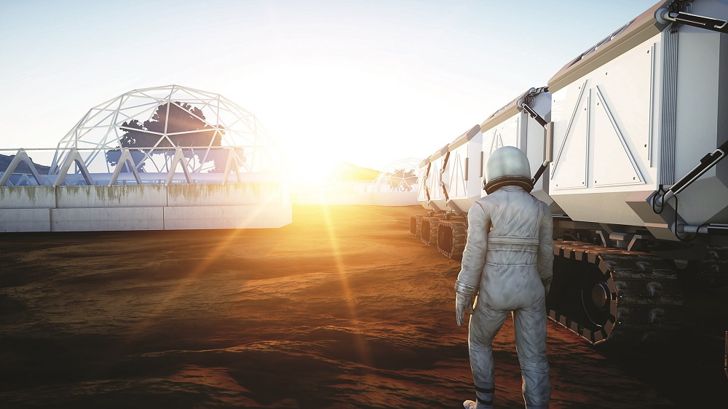
Introduction :
Is there life on Mars? One day, answer to this question would be as simple to say as life exists on earth.
Introducing our newest concept vehicle designed demanding for travelling on the surface of the Red planet Mars. The next generation of mankind could be travelling and working in a high tech vehicle for more exploration on the planet. Ours is a splendid size motor vehicle and has massive wheels for moving over dunes , rocks and huge craters on its surface. Also it is a high tech automatic car with installation of MOXIE.

Slide 3
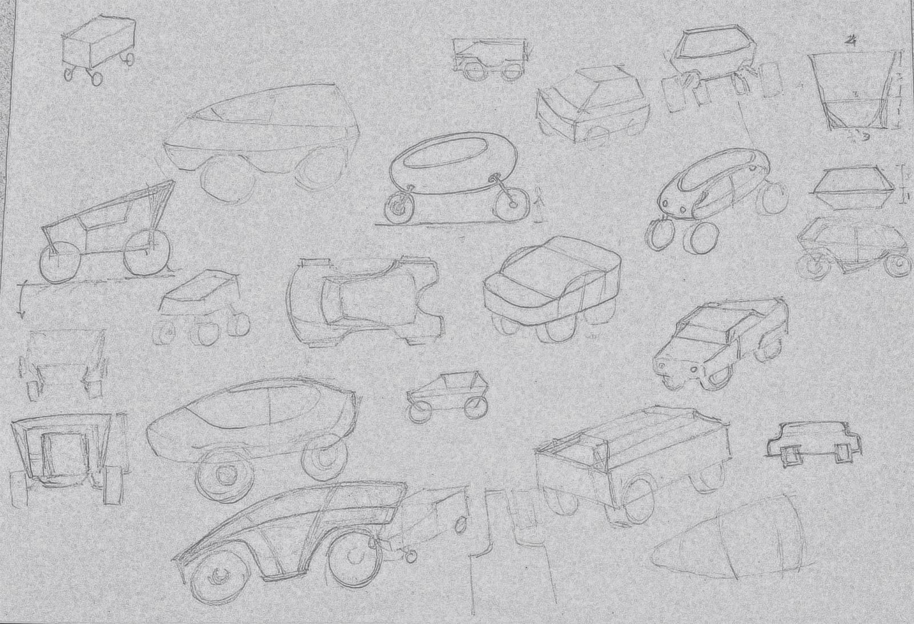
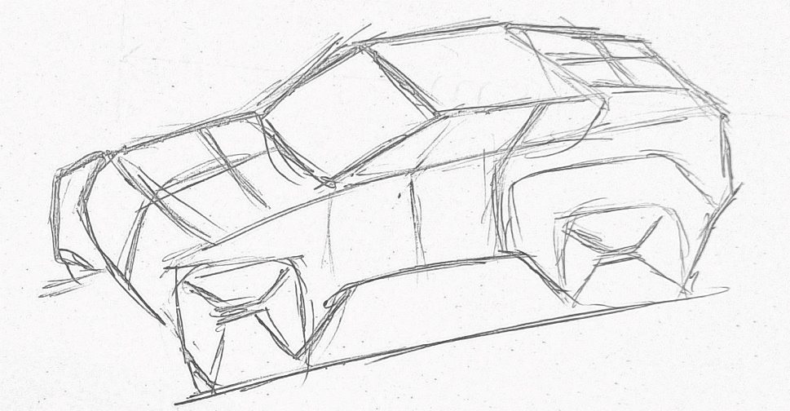
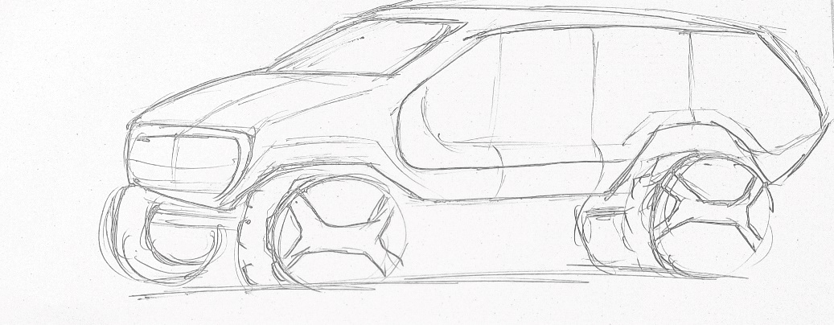
Concept:
Initial phase of car
Rough sketches
Initial phase of car

Slide 4
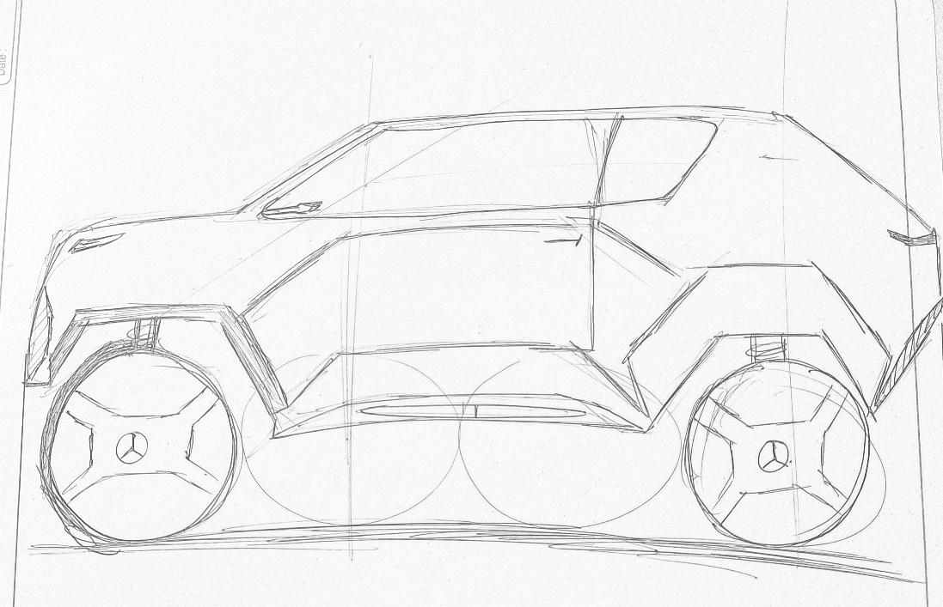
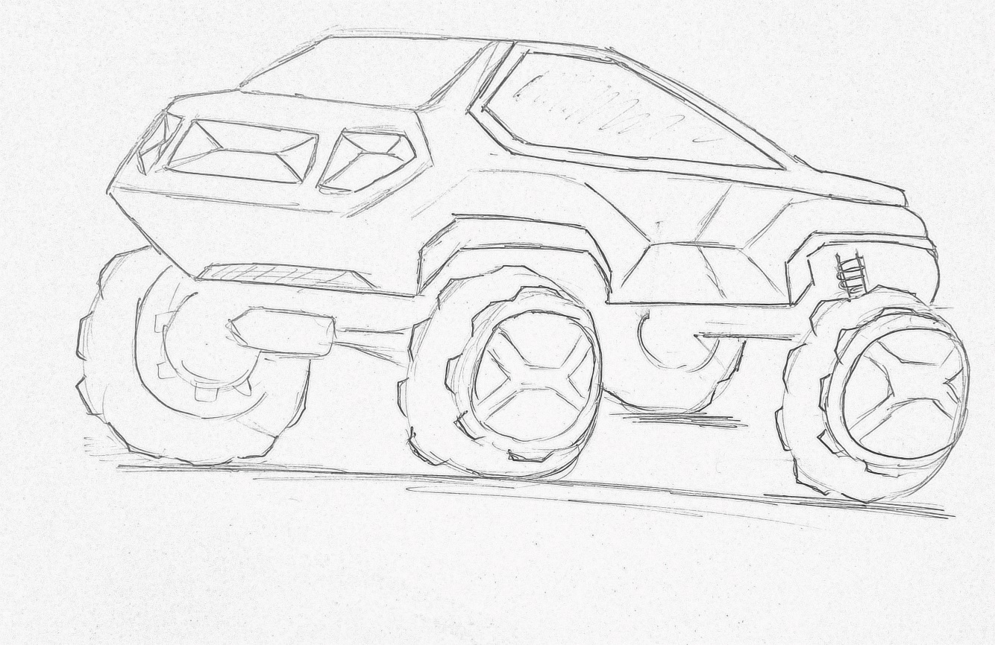
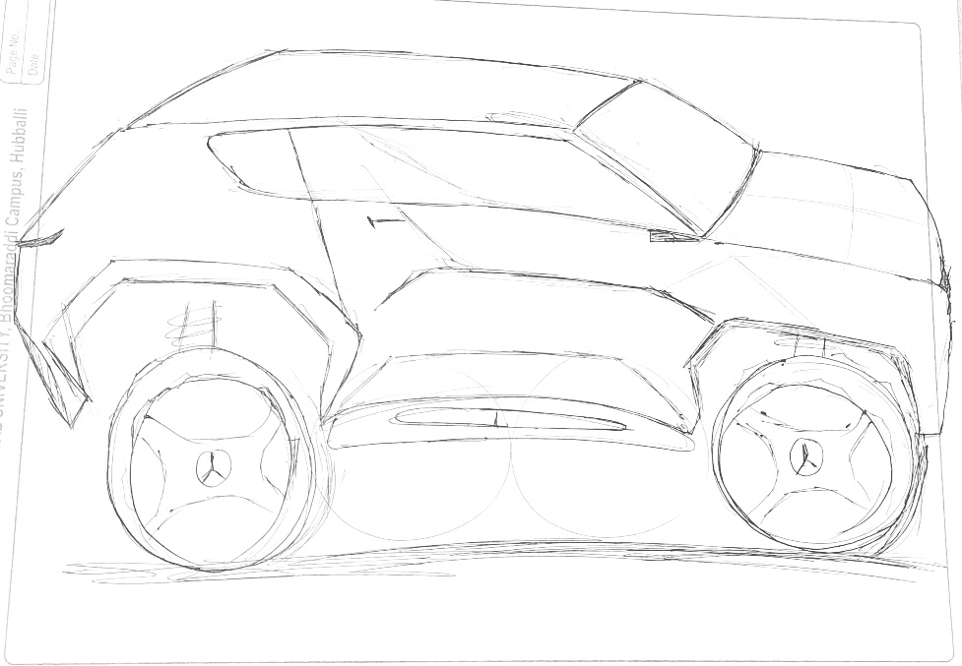
Final Sketches:
Side View
Back View
Side View

Slide 5
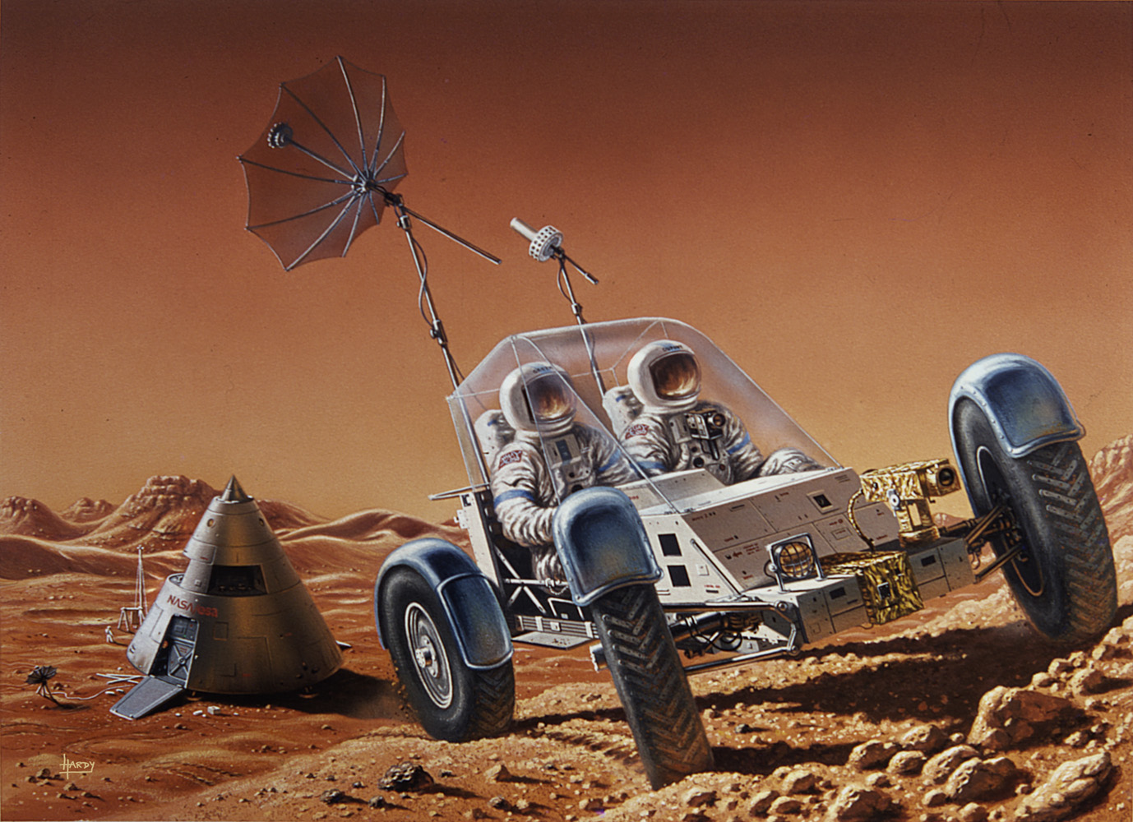
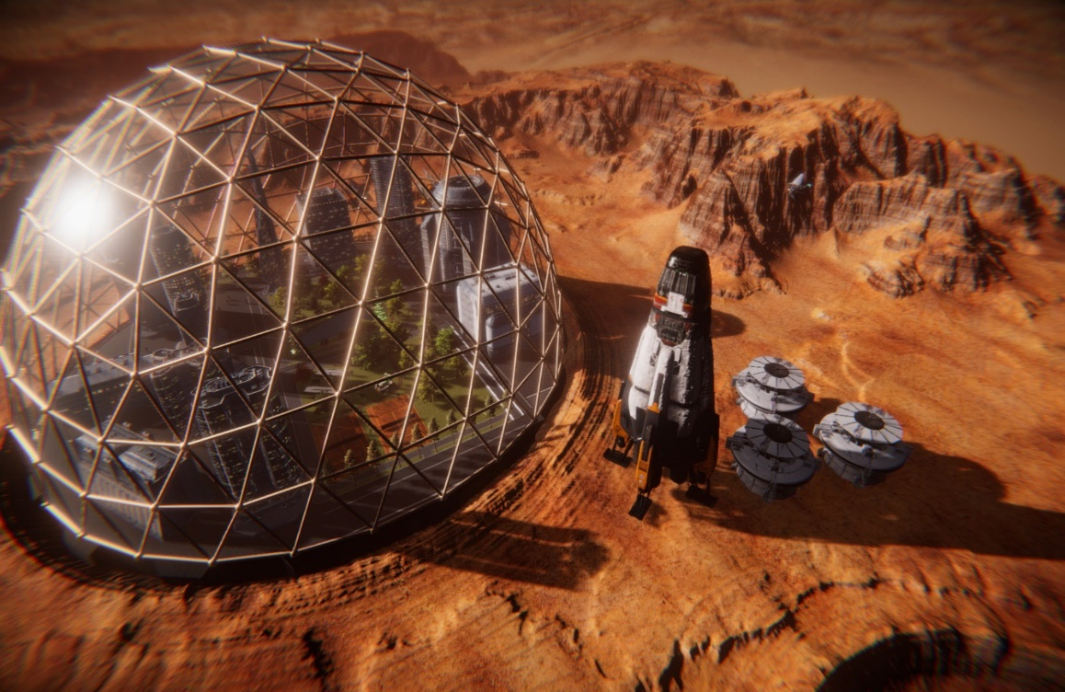
Target Consumer:
In the light of building concept for off- roaders, one popular design that seems most plausible is that of SUV’s ,Buggy Carts, Mini trucks, Monster truck. This vehicle is meant for these Off- roaders who would participate in frequent off-roading travel which would require them to stay protected from the harsh Martian environment outside of the colonies and can explore new things on planet Mars.

Slide 6
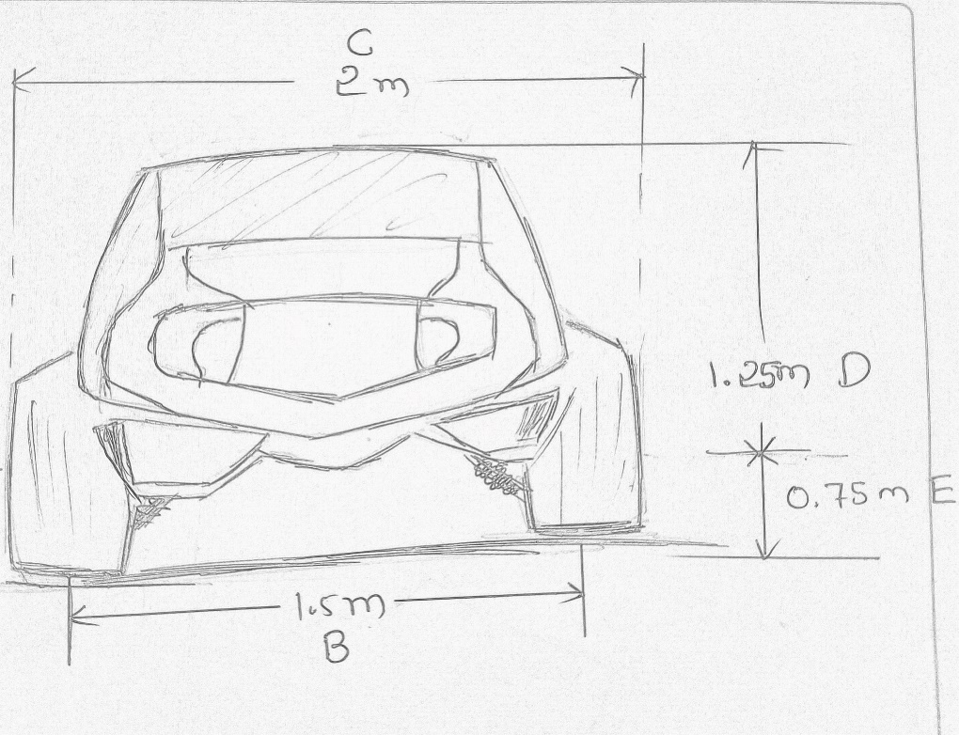
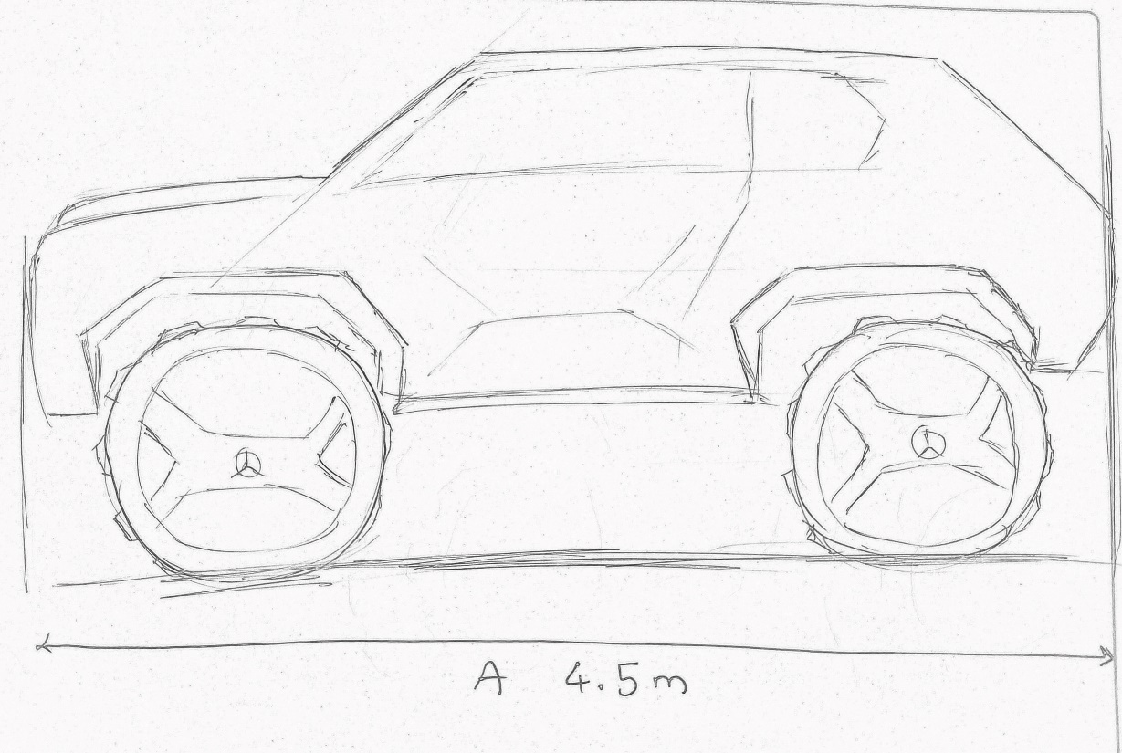
Vehicle Dimension:
A- Overall length : 4.5m
B- Overall width : 1.5m
C- Track width : 2m
D- Overall Height : 1.25m
E- Ground clearance : 0.75m
Martian surface requires more clearance. We upgraded the dimensions of existing car to make suitable for Martian surface. We have chosen large tire for more clearance.

Slide 7
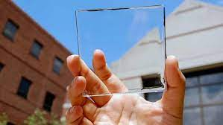
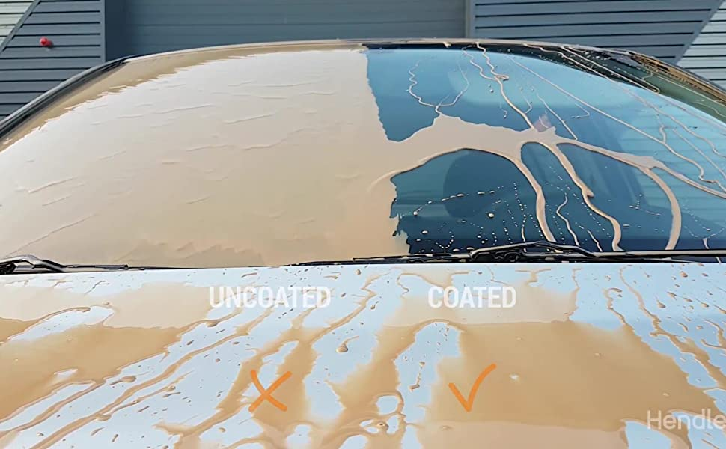
Exterior:
Transparent solar panel:
For those with even a vague knowledge of how solar panels work, the concept of a transparent solar panel might seem absurd. Solar panels absorb solar energy and convert it into electricity. How can a panel simultaneously absorb solar energy while allowing it to pass through?
The concept is simple: capture the invisible UV spectrum while letting the visible spectrum pass through.
Dirt proof windshield:
Self-cleaning glass is a specific type of glass with a surface that keeps itself free of dirt and grime.

Slide 8
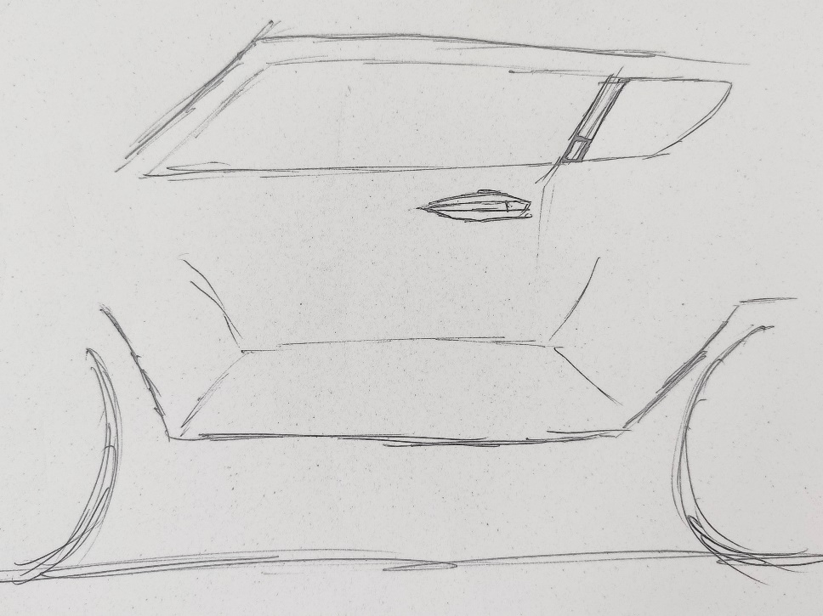
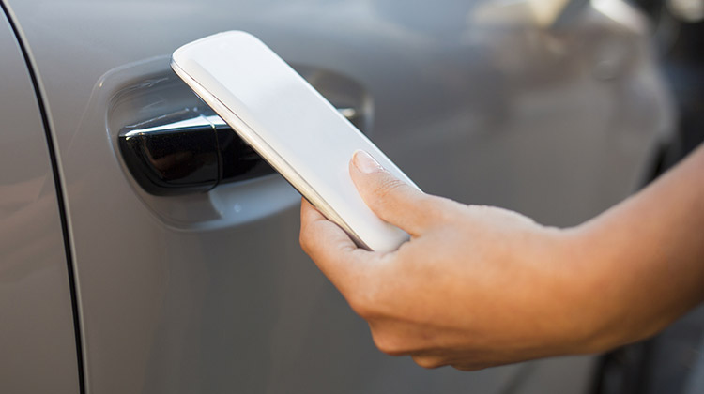
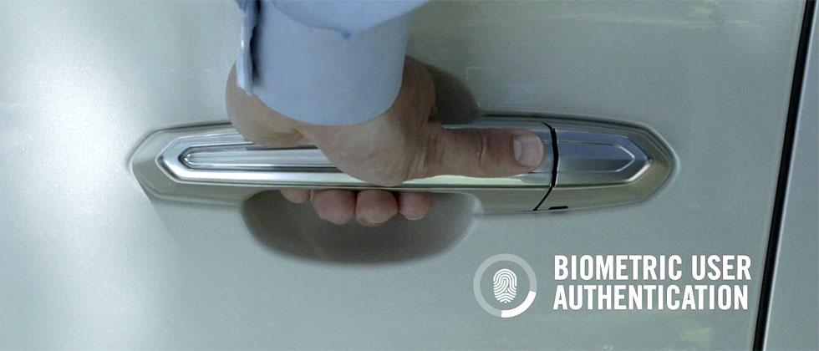
NFC
NFC (Near field Communication for Access Control System)This feature would be installed to ensure access to a rented vehicle is controlled and only the person with an issued access card can scan the card and open the door.This also helps in collection of user data for product performance analysis, and tracking of travel journey.
The user can enter the car by authenticating his finger print.
Finger print scanner

Slide 9
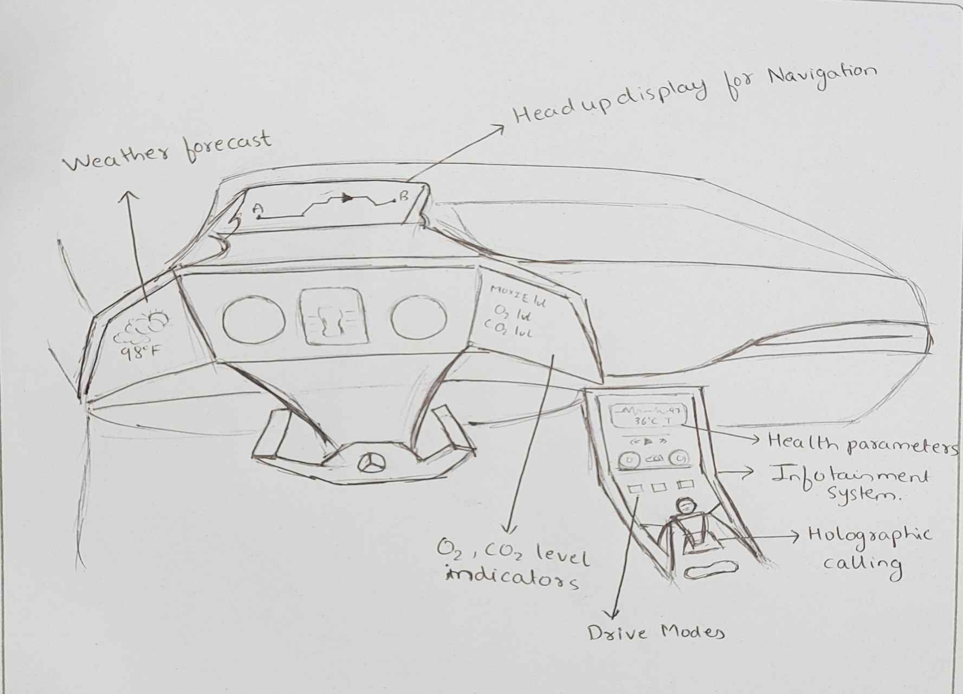
Interior:
The vehicle provides for a fully autonomous drive, hence dash board is made fully touch screen with important auxiliary features listed on the right.
Dash board design

Slide 10
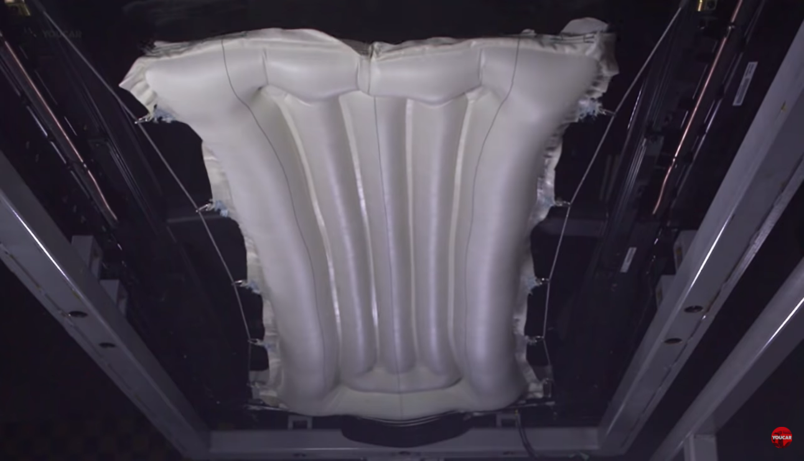
Head Up Display(HUD) for Navigation:
HUD is a transparent display that is mounted on to the dashboard of the car and displays crucial information and data without diverting the driver from their usual viewing position. By this, we mean that the driver can be in straight heads up position and have access to all the vital information that they need to see while driving the car.
Roof Air Bag:
Roof airbags protect the passengers from head and neck injury by covering the ceiling of the vehicle in only 0.08 seconds for it's inflating from the back of the vehicle to the front

Slide 11
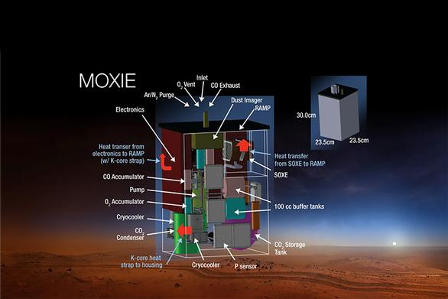
MOXIE
Main Job | To produce oxygen from the Martian carbon-dioxide atmosphere
Mass | 17.1 kilograms
Weight | 37.7 pounds on Earth, 14.14 pounds on Mars
Power | 300 watts
Volume | 9.4 x 9.4 x 12.2 inches (23.9 x 23.9 x 30.9 centimeters)
Oxygen Production Rate | Up to 10 grams per hour (At least 0.022 pounds per hour)
Operation Time | Approximately one hour of oxygen (O₂) production per experiment, which will be scheduled intermittently over the duration of the mission.

Slide 12
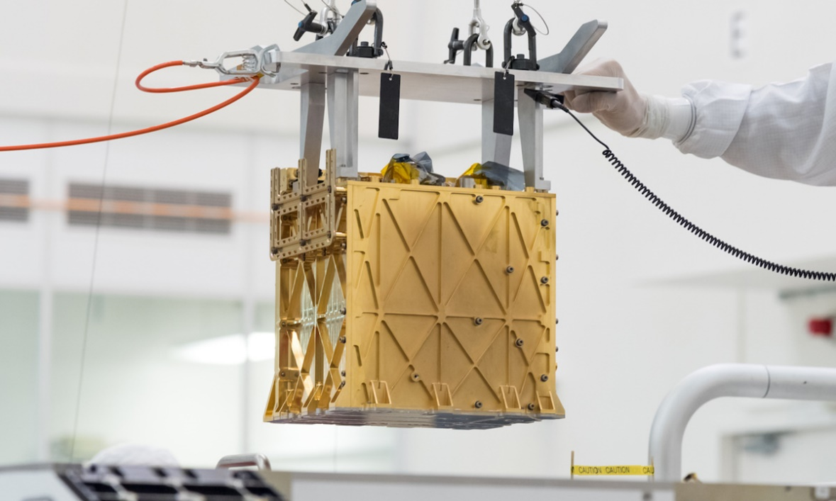
Things to know about MOIXE:
MOXIE makes Oxygen on Mars.
MOXIE Helps Future Explorers.
MOXIE Breathes like a Tree.
Our Concept is to install MOXIE to provide O2 in the car.
MOXIE produces 10gm of O2 per hour which is equal to 896.5L
of O2 gas in Volume.
A human breathes 5-6mL of O2 per minute , for an hour human
breathes 350mL – 360mL of O2.
By our calculation 2 individuals can survive on in our car.

Slide 13
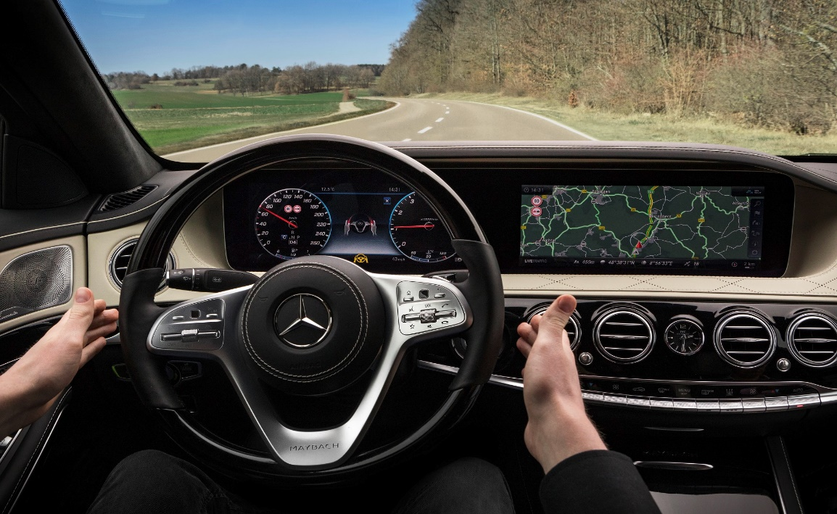
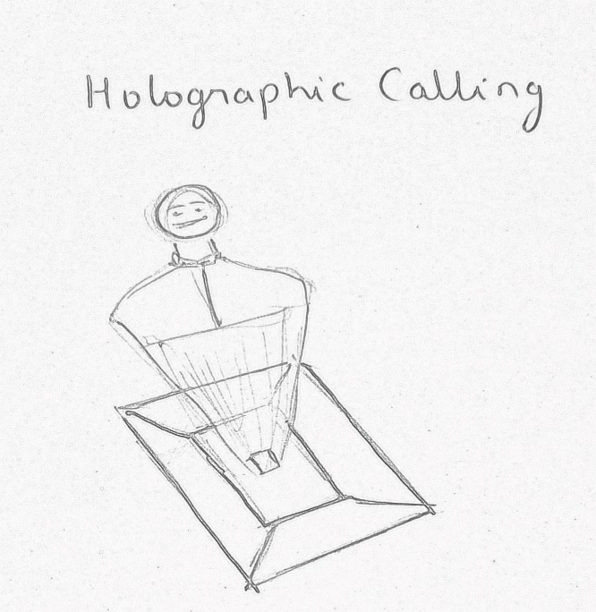
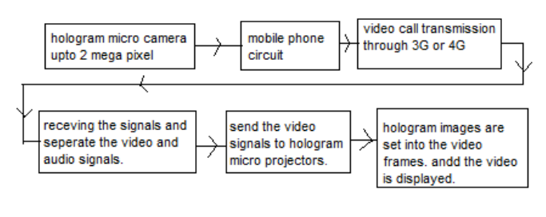
Auto Start:
Car automatically get started when user occupies the driver seat .
Execution of Mobile Video Calls utilizing Holographic View (internationaljournalssrg.org)

